Slide 1
Clean Code
Yogesh Naik

Slide 2
Any fool can write code that a computer can understand. Good programmers write code that humans can understand.
— Martin Fowler
(http://martinfowler.com/)
If you want your code to be easy to write,
make it easy to read — Robert C. Martin
(http://blog.cleancoder.com/)

Slide 3
You know you are working with clean code when each routine you read, turns out to be pretty much what you expected
— Ward Cunningham
(Inventor of Wiki)

Slide 4
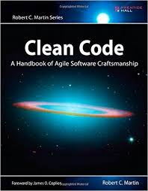

Robert C. Martin (Uncle Bob)

Slide 5
Names
Use intention revealing names
int d; // elapsed time in days
int days;
Instead use
int elapsedTimeInDays;
Even better
int elapsedDays;
Examples from Code base
FallOutWriter.java (_HR)
Base64Coder.encodeLines()

Slide 6
Intension Revealing Names
Consider this
public List<int[]> getThem() { List<int[]> list1 = new ArrayList<int[]>();
for (int[] x : theList) if (x[0] == 4) list1.add(x); return list1;
}
After changing names and the magic numbers
public List<int[]> getFlaggedCells() { List<int[]> flaggedCells = new ArrayList<int[]>(); for (int[] cell : gameBoard) if (cell[STATUS_VALUE] == FLAGGED) // => if(isFlaggedCell) flaggedCells.add(cell); return flaggedCells; }

Slide 7
Intension Revealing Names
public List<int[]> getFlaggedCells() { List<int[]> flaggedCells = new ArrayList<int[]>(); for (int[] cell : gameBoard) if (cell[STATUS_VALUE] == FLAGGED) // => if(isFlaggedCell) flaggedCells.add(cell); return flaggedCells; }
Object Oriented way
public List<Cell> getFlaggedCells() { List<Cell> flaggedCells = new ArrayList<>(); for (Cell cell : gameBoard) if (cell.isFlagged()) flaggedCells.add(cell);
return flaggedCells; }
With Java 8 this becomes just one liner.
public List<Cell> getFlaggedCells() { return gameBoard.stream().filter(Cell::isFlagged).toList(); }

Slide 8
Use Pronounceable Names
If you can’t pronounce it, you can’t discuss it
private Date genymdhms;
private int getYYYY() {return this.year;}
Is it not better this way
private Date generationTimestamp;
private int getYear() {return this.year;}
FalloutWriter.suppressedSno
TransactionExecutor.nbEdits

Slide 9
Names
Make them searchable
MAX_CLASSES_PER_STUDENT is more searchable than 7
Avoid encoding
AccountServiceImpl
IShapeFactory
Do not add unnecessary prefixes, like prefixing name of the project before every class.

Slide 10
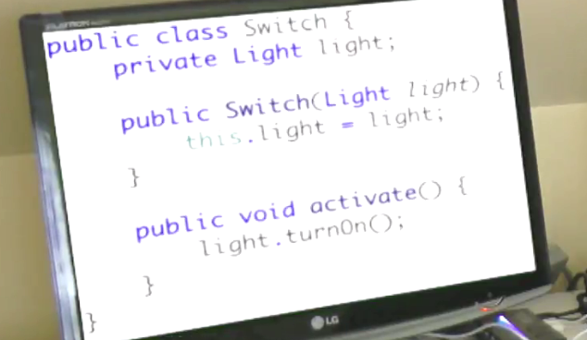
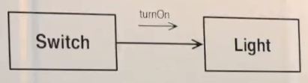
Interface Names
Given a Switch and Light, design software that will turn on light when switch is activated.
Switch should be able to control anything and not just light. Why should Switch know anything about Light.

Slide 11
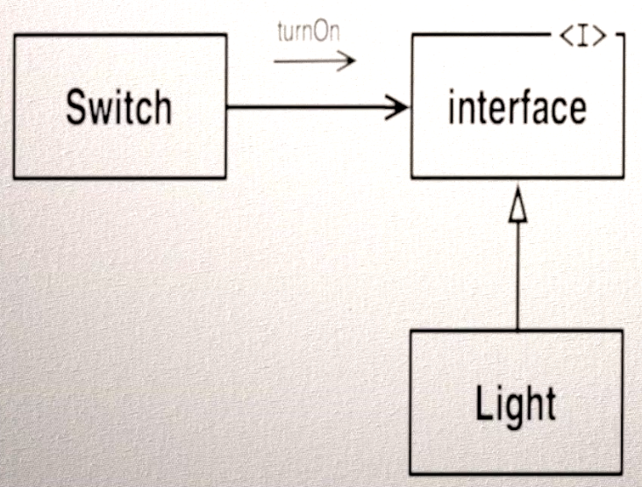
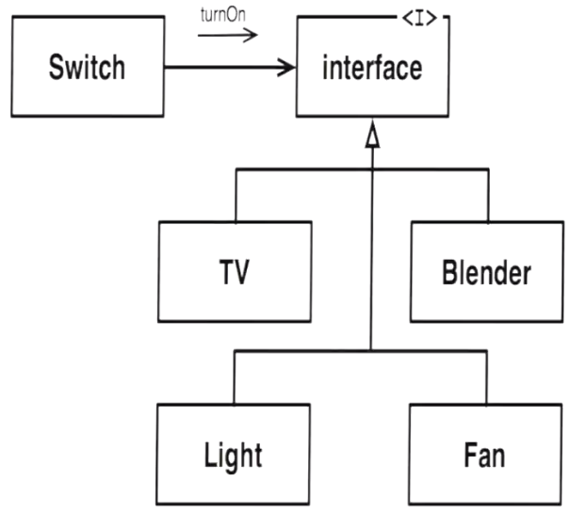
Interface Names
Interface has turnOn() method which Light then implements.
What should be name of the Interface here?
AbstractLight?
ILight? Or Light (implemention=LightImpl)?
Clearly, Interface has to do more with Switch than just Light or just TV or etc.
Light, TV, etc. are forced to implement it. It is the Switch that is more tightly coupled with that Interface.
Device? (It’s a noun)
TurnOnAble?
ActivateAble?
Switchable (Adjective)
The name of interface is more to do with Classes that use them rather than classes that implement them.

Slide 12
Interface Names
Coming back to AcccountServiceImpl
Do we really need AccountService as Interface? Can it be just AccountService class that implements all methods?
Will there ever be multiple implementations of AccountService interface?
We can have AccountService as class and MockAccountService that extends from AccountService as mock implementation.
Or think in terms of who is using AccountService interface? And name the interface based on who is using it rather than who is implementing it.
In Web app, typically it would be AccountController who uses AccountService. In such case, we can simply have AccountService being a class rather than interface.
Or call the interface “AccountControllerService” or “AccountControllable” or “AccountServiceAble”?

Slide 13
Names – Choose parts of speech well
Name of class or variable should be noun
MessageParser
Account
Try to avoid noise words like Manager, Processor, Data, Info, etc.
Method names should start with verb
Boolean variables or methods that return boolean should be written like predicates
Boolean isEmpty, isTerminated
They read well in if statements “if(isTerminated)”
Enum should be adjactives
enum Status {PENDING, CLOSED, CANCELLED}
enum Size {BIG, MEDIUM, SMALL}

Slide 14
Scope Rule for variables
Smaller the scope of the variable smaller the name
Larger the scope of the variable larger the name.
for(TestResult tr : configIssues) { Element element = createElement(d, tr); rootElement.appendChild(element); }
“d” should be document as it has larger scope.
“tr” is fine as it has smaller scope.
For “element” if you use “e” or “elem” that is fine too as it has smaller scope confined to the for loop.
TileProcessor.commitBundle (use of “i” in for loop) or (Throwable t) / (Exception e) in catch block

Slide 15
Scope Rule for method & class
Smaller the scope of the method or the class larger the name
Larger the scope of the method or the class smaller the name.
Inherited classes with larger scope can have larger names. E.g. SavingsAccount extends Account.
Private classes with smaller scope can have larger names.
private void getNextBestFromQueue()
public synchronized String getNextFileName() { String nextFile = null; if (!rejected.isEmpty()) { nextFile = getNextBestFromQueue(); } if (nextFile == null) { nextFile = getNextBestFromFile(); } ... return nextFile; }

Slide 16
Small Methods
Methods should be small.
4 to 5 lines are good.
More than 10 lines is big.
Smaller methods are easy to understand and reuse.
Large methods are less reusable. (Copy/Paste is not reusing)
Large methods may include functionality that belong in different class. (TransactionExecutor.execute from A2MDS)
Large method/class may hide the classes.
Smaller well named methods in well named classes will make it easier to navigate the code.
ArchiveToMdsOptions.processArguments()
FallOutWriter.readableFileLines()

Slide 17
Same level of abstraction
All the statements in a method should be at one level of abstraction.
void compute() { input(); flags|= 0x0080; output(); }
If the statements are not at one level of abstraction extract them in methods with meaningful names.
Methods having one abstraction level are likely to do one thing.
Too much indentation in a method is a dead giveaway that the method is doing things at different levels of abstraction
FallOutWriter.readableFileLines()

Slide 18
Small Methods
Instead of adding a comment on a code block, extract it into a method with name same as the comment.
Minimize the no of local variables.
Minimize the indentations in a method.
(FallOutWriter.readableFileLines() OR getPoi())
// ensure everything is processed if (!transactions.isEmpty()) { commitPerTransactionBundle(newFeatureRegister, map, archivesPerTransaction); } OR processRemainingTransactionsIfAny();

Slide 19
Method Parameters
Keep the method/constructor parameters to the minimum. Usually less than 3 variables.
Circle makeCircle(double x, double y, double radius); Circle makeCircle(Point center, double radius);
Avoid boolean parameters.
doMakeResponse(context, request, true)
Avoid passing in nulls or returning nulls.
No output args (e.g. passing StringBuilder or Collection to which things get appended/added inside the method)

Slide 20
Switch Cases
Functions with switch statements are likely to do N things.
Switch cases are likely to get scattered throughout the code.
Open ended switch violates OCP.

Slide 21
Example
Consider this method of Bird class:
double getSpeed() { switch(type) { case EUROPEAN: return getBaseSpeed(); case AFRICAN: return getBaseSpeed() - getLoadFactor() * numberOfCoconuts; case NORWEGIAN_BLUE: return (isNailed) ? 0 : getBaseSpeed(voltage); } }

Slide 22
Polymorphism
abstract class Bird { abstract double getSpeed() } class European extends Bird { double getSpeed() { return getBaseSpeed(); } } class African extends Bird { double getSpeed() { return getBaseSpeed() - getLoadFactor() * numberOfCoconuts; } } class NorwegianBlue extend Bird { double getSpeed() { return (isNailed) ? 0 : getBaseSpeed(voltage); } }
Bird
European
African
NorwegianBlue

Slide 23
When Switch cases are harmless
When there is no possibility of more cases.
When switch is used for creation of Polymorphic objects. Like in a Factory.
When switch cases are managed locally and can not scatter throughout the system.

Slide 24
Objects
Objects should hide their internal structure.
Follow ‘Tell Don’t Ask’ (Law of Demeter).
Caller should not ask state of an object and make decisions outside based on state
Avoid train wrecks - Don’t ask.
((EditSaveCustomizer) master.getModelisable() .getDockablePanel() .getCustomizer()) .getSaveItem().setEnabled(Boolean.FALSE.booleanValue());
Instead tell the object to perform task
master.allowSavingOfCustomisations();
AddressEditFactory.setAttributes()
sourcePlace.getPoi().getArchivePlace().getPois().get(0).setLatitudeOfPoi(attributes.get(0).getLatitudeOfPoi());

Slide 25
Law of Demeter (Tell Don’t Ask)
Law of Demeter for functions requires that a method m of an object O may only invoke the methods of the following kinds of objects:
O itself
m's parameters
Any objects created/instantiated within m
O's direct component objects
A global variable, accessible by O, in the scope of m
In particular, an object should avoid invoking methods on an object returned by another method.
The law can be stated simply as "use only one dot". That is, the code a.b.Method() breaks the law where a.Method() does not.
As an analogy, when one wants a dog to walk, one does not command the dog's legs to walk directly; instead one commands the dog which then commands its own legs.

Slide 26
Classes
Classes should be small.
Small classes follow Single Responsibility Principle (SRP).
The class should be Cohesive.

Slide 27
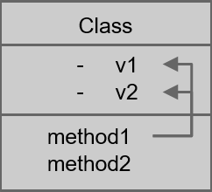
Cohesion
Classes should have a small number of instance variables.
More variables a method manipulates
the more cohesive that method is to its class.
The more cohesive the methods are the more cohesive the class will be.
We want the classes to have high cohesion.
When classes lose cohesion, split them!
FallOutWriter.readableFileLines

Slide 28
Comments
// Check to see if the employee is eligible for full benefits
if ((employee.flags & HOURLY_FLAG) && (employee.age > 65))
Explain yourself in code by converting comments into proper method name:
if (employee.isEligibleForFullBenefits())
Turn comments into compile-able code
Turn comments explaining variables into variable names
Turn comments explaining methods into method names
Turn comments describing blocks of code into their own methods. Use the comment as the method name

Slide 29
Comments
FallOutWriter.readableFileLines()
createFailuresSeparatedBySemicolon / joinFailuresBy
getReasonMessage()
getViolationMessageIfNotNull()
getDetailedReasonFromReasonVariable()

Slide 30
Accepted Comments
Legal Comments
Informative comments
// format matched kk:mm:ss EEE, MMM dd, yyyy
Pattern timeMatcher = Pattern.compile("\\d*:\\d*:\\d* \\w*, \\w* \\d*, \\d*");
// This is implementation of Levenshtein Distance Algorithm for comparing strings
Javadocs in Public API

Slide 31
Good Comments
Explanation of intent
public void testConcurrentAddWidgets() throws Exception {
….
//This is our best attempt to get a race condition
//by creating large number of threads.
for (int i = 0; i < 25000; i++) {
WidgetBuilderThread widgetBuilderThread = new WidgetBuilderThread(widgetBuilder, parent);
Thread thread = new Thread(widgetBuilderThread);
thread.start();
}
….
}

Slide 32
Bad Comments
Journal Comments / History comments
Auto generated comments
Closing brace comments e.g. “} // while”
Identity comments - /** Added by Yogesh Naik */
Non local information (setPort(int) // default 8099)
Commented out code – Simply delete it
/** the name */ private String name; /** the version */ private int version; /** Default constructor */ public Example() { }

Slide 33
Clean Tests
One Assert per Test
Single Concept per Test
public void testAddMonths() { SerialDate d1 = SerialDate.createInstance(31, 5, 2004); SerialDate d2 = SerialDate.addMonths(1, d1); assertEquals(30, d2.getDayOfMonth()); assertEquals(6, d2.getMonth()); assertEquals(2004, d2.getYYYY()); }
PaymentMethodRuleTest
VehicleTypesRuleTest
AddressesRuleTest

Slide 34
Clean Tests - FIRST
FAST
run quickly (many hundreds or thousands per second)
Independent / Isolates
should not depend on each other
Failure reason is obvious
Repeatable
ability to run tests in any environment and in any order
Self-Validating
either pass or fail
No need to manually check the logs
Timely
Written before production code

Slide 35
Tips to write testable code
Separate Business Logic from how the business logic is to be executed/invoked
REST Controller (ObservationWsController)
Messaging / ActiveMQ (TransactionalMessageListener)
EJB
Follow SRP
E.g. FalloutWriter – In this class we are doing two things. Transforming fallouts into a certain format and then writing them into a file.

Slide 36
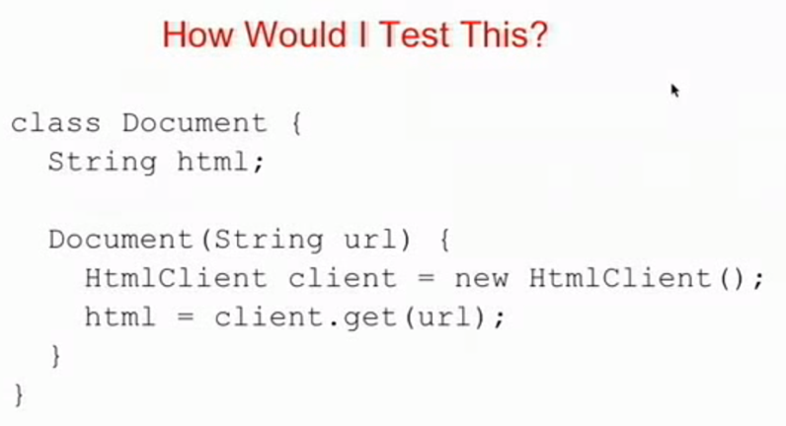
How to make code “testable”?

Slide 37
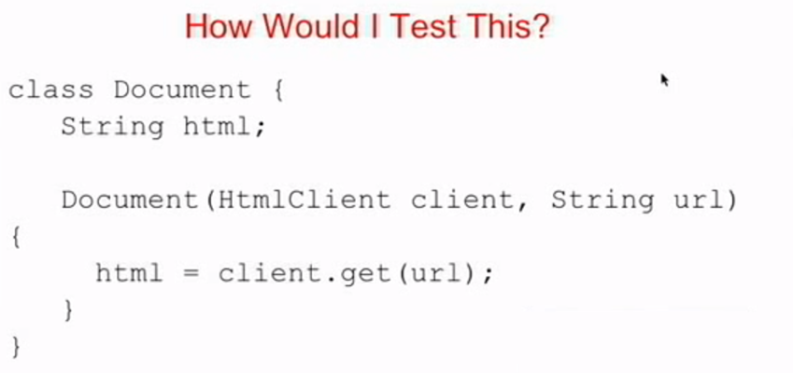
How to make code “testable”?

Slide 38
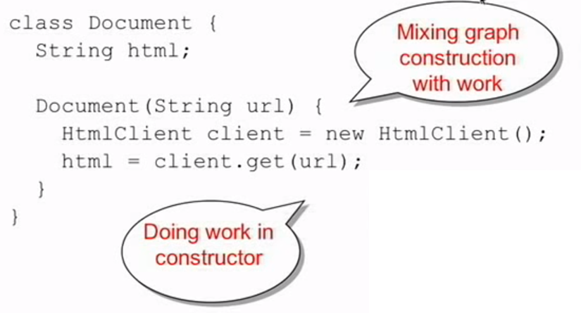
How to make code “testable”?

Slide 39
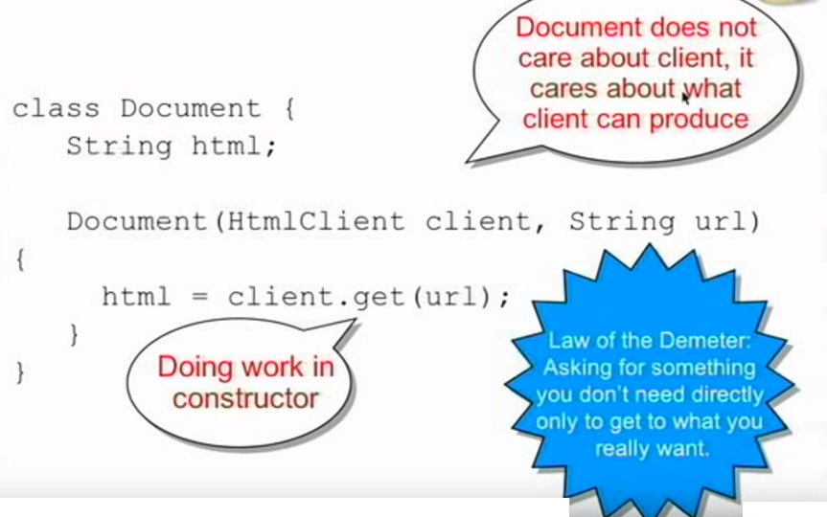
How to make code “testable”?

Slide 40
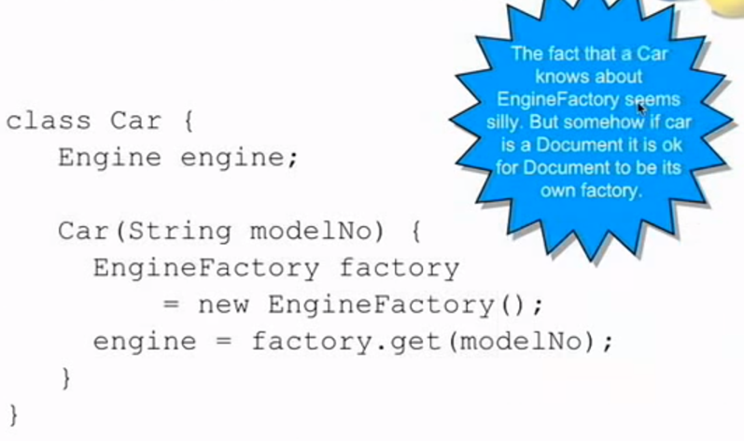
How to make code “testable”?

Slide 41
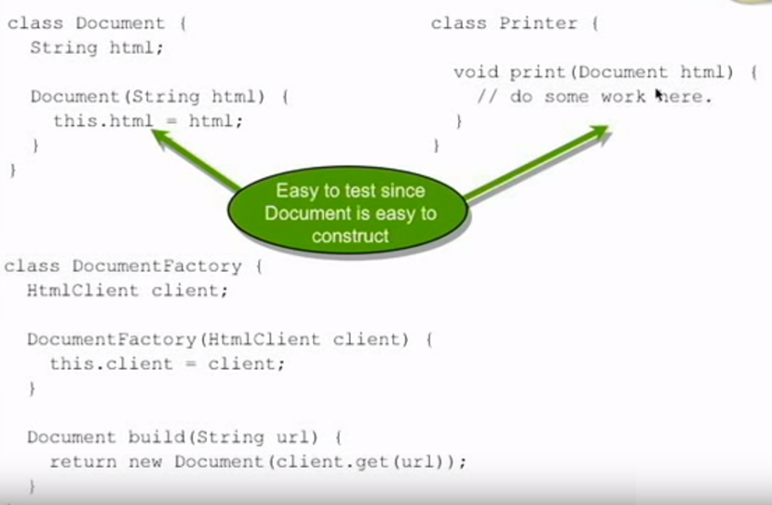
How to make code “testable”?

Slide 42
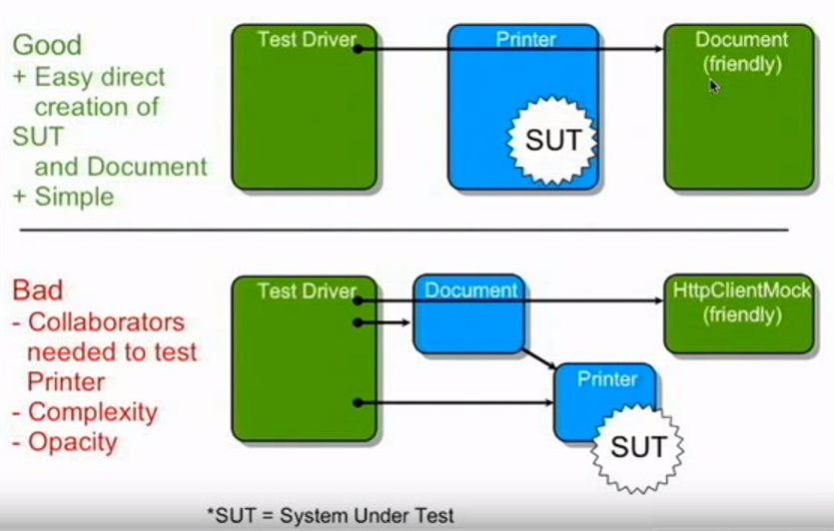
How to make code “testable”?

Slide 43
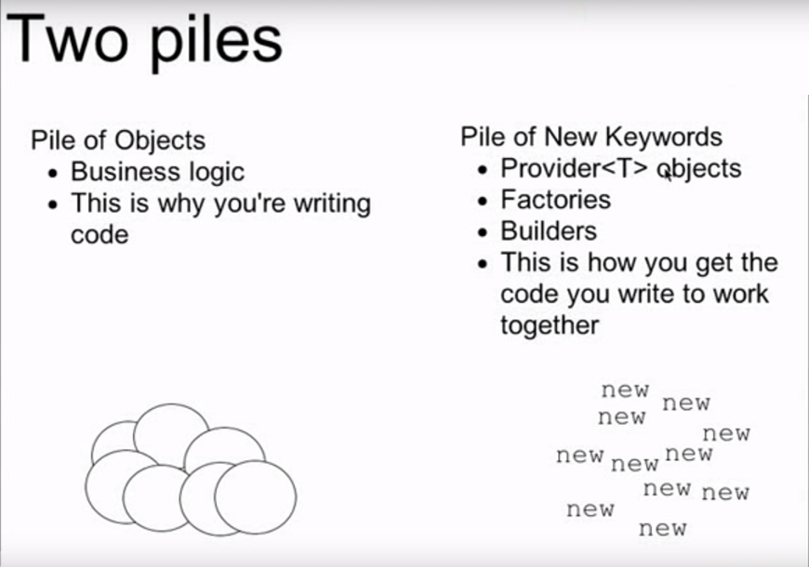
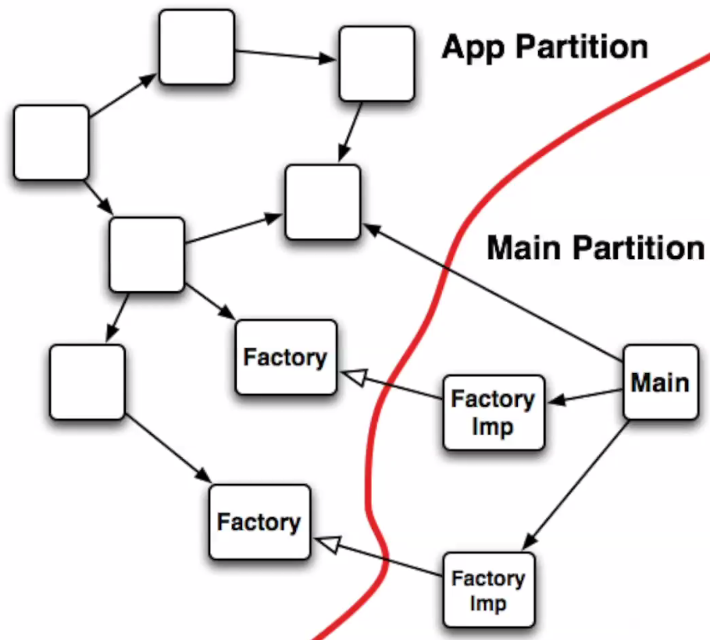
How to make code “testable”?

Slide 44
Some Tips for better code
Instead of concatinating strings with + use String.format() to create log messages
String.format(“%d Total records processed from file %s”, totalRecords, fileName);
If using slf4j logger, it is easier like:
LOGGER.info(“{} Total records processed from file {}”, totalRecords, fileName);
Carefuly choose the log level when writing log statements
Coding Practices Checklist.docx
Clean Code Examples

Slide 45
Don’t reinvent the wheel
Apache Libs
http://commons.apache.org/components.html
org.apache.commons.io.IOUtils.closeQuietly
org.apache.commons.lang3.StringUtils
Google Guava Libs
https://github.com/google/guava
https://github.com/google/guava/wiki https://github.com/google/guava/wiki/ImmutableCollectionsExplained

Slide 46
Recap
Use Intention revealing names
Scope rule for variable/method/class names
Use parts of speech well
Small methods
Number of parameters to a method/constructor
Methods should be on one level of abstraction and classes should be highly Cohesive
Switch Cases vs OCP
Law of Demeter (Tell don't ask)
Good vs Bad Comments
Clean FIRST Tests

Slide 47
Final thoughts
Follow Boy’s Scout Rule
Leave the code a little bit cleaner than previous version before committing your changes
Any small change e.g. refactoring a variable name with more meaningful name
Extracting small piece of code into a method to reduce size of a larger method. E.g. closing streams/Thread.sleep()
Read the Clean Code book by Robert C. Martin for more explaination and tips.
Read the “Effective Java” book by Joshua Bloch
Attend my next session on SOLID Principles 4th May at 2 pm

Slide 48
Quiz
Number of parameters to a method/constructor?
How small a method should be?
What is SRP and OCP?
How to identify if Law of Demeter is broken?
One of the quotes about Clean Code that we saw at the beginning of this session?

Slide 49
Quiz
Scope rule for variable/method/class names?
When switch cases are harmless?
2 examples of GOOD comments and BAD comments?
How to make a class highly Cohesive?
Full form of Clean FIRST Tests?

Slide 50
Feedback & Questions?

